Slide 1
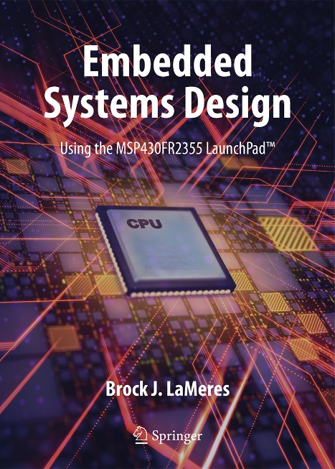

Embedded Systems Design
Chapter 5: Getting Started Programming the MSP430 in Assembly
5.1 The Anatomy of an Assembly Program File
Brock J. LaMeres, Ph.D.

Slide 2
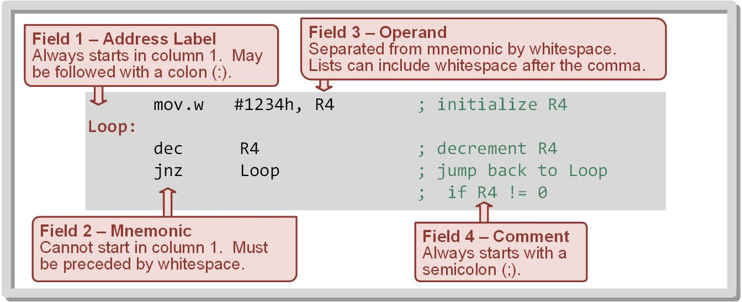
Ch. 5: Getting Started Programming the MSP430 in Assembly
5.1.1 The Basics
Assembly files in CCS end with *.asm (i.e., main.asm)
5.1 The Anatomy of an Assembly Program File

Slide 3
Ch. 5: Getting Started Programming the MSP430 in Assembly
5.1.1 The Basics
Assembly files in CCS end with *.asm (i.e., main.asm)
Each line in an MSP430 assembly source file can either be empty, an instruction, a comment, an assembler directive, or a macro invocation.
5.1 The Anatomy of an Assembly Program File

Slide 4
Ch. 5: Getting Started Programming the MSP430 in Assembly
5.1.1 The Basics
Assembly files in CCS end with *.asm (i.e., main.asm)
Each line in an MSP430 assembly source file can either be empty, an instruction, a comment, an assembler directive, or a macro invocation.
Any line that is not empty is called a Statement.
5.1 The Anatomy of an Assembly Program File

Slide 5
Ch. 5: Getting Started Programming the MSP430 in Assembly
5.1.1 Instruction Statements
Assembly language source statements can contain four ordered fields: address label mnemonic operand list comment
5.1 The Anatomy of an Assembly Program File

Slide 6
Ch. 5: Getting Started Programming the MSP430 in Assembly
5.1.1 Instruction Statements
Address Labels
5.1 The Anatomy of an Assembly Program File

Slide 7
Ch. 5: Getting Started Programming the MSP430 in Assembly
5.1.1 Instruction Statements
Address Labels – used to mark a point in the program that can be referenced by other instructions; used in looping and conditional execution of code.
5.1 The Anatomy of an Assembly Program File

Slide 8
Ch. 5: Getting Started Programming the MSP430 in Assembly
5.1.1 Instruction Statements
Address Labels – used to mark a point in the program that can be referenced by other instructions; used in looping and conditional execution of code.
Assembler attaches address label so the programmer does not have to remember the exact address of an instruction.
Label can be followed by an optional colon (:) which is not treated as part of the label, but is instead color-coded by CCS.
5.1 The Anatomy of an Assembly Program File

Slide 9
Ch. 5: Getting Started Programming the MSP430 in Assembly
5.1.1 Instruction Statements
Mnemonic
5.1 The Anatomy of an Assembly Program File

Slide 10
Ch. 5: Getting Started Programming the MSP430 in Assembly
5.1.1 Instruction Statements
Mnemonic - a descriptive name for the op-code that can be used when discussing the instruction functionally.
5.1 The Anatomy of an Assembly Program File

Slide 11
Ch. 5: Getting Started Programming the MSP430 in Assembly
5.1.1 Instruction Statements
Mnemonic - a descriptive name for the op-code that can be used when discussing the instruction functionally.
Must be preceded by whitespace, either after the label or as the beginning of the line.
All op-code mnemonics in the Chapter 4 Tables are supported.
5.1 The Anatomy of an Assembly Program File

Slide 12
Ch. 5: Getting Started Programming the MSP430 in Assembly
5.1.1 Instruction Statements
Operand
5.1 The Anatomy of an Assembly Program File

Slide 13
Ch. 5: Getting Started Programming the MSP430 in Assembly
5.1.1 Instruction Statements
Operand - Provides additional information needed to complete the instruction.
5.1 The Anatomy of an Assembly Program File

Slide 14
Ch. 5: Getting Started Programming the MSP430 in Assembly
5.1.1 Instruction Statements
Operand - Provides additional information needed to complete the instruction.
Follows the mnemonic field, separated by a whitespace.
For operands that require a list, the values are separated by a comma delimited with white space characters being optional after the comma.
5.1 The Anatomy of an Assembly Program File

Slide 15
Ch. 5: Getting Started Programming the MSP430 in Assembly
5.1.1 Instruction Statements
5.1 The Anatomy of an Assembly Program File

Slide 16
Ch. 5: Getting Started Programming the MSP430 in Assembly
5.1.1 Instruction Statements
Comments – Text used for documentation.
5.1 The Anatomy of an Assembly Program File

Slide 17
Ch. 5: Getting Started Programming the MSP430 in Assembly
5.1.1 Instruction Statements
Comments – Text used for documentation.
All comments must start with a semicolon (;).
Comments are optional, but are highly recommended for readability.
Can also be on their own line as long as preceded with semicolon (;).
5.1 The Anatomy of an Assembly Program File

Slide 18
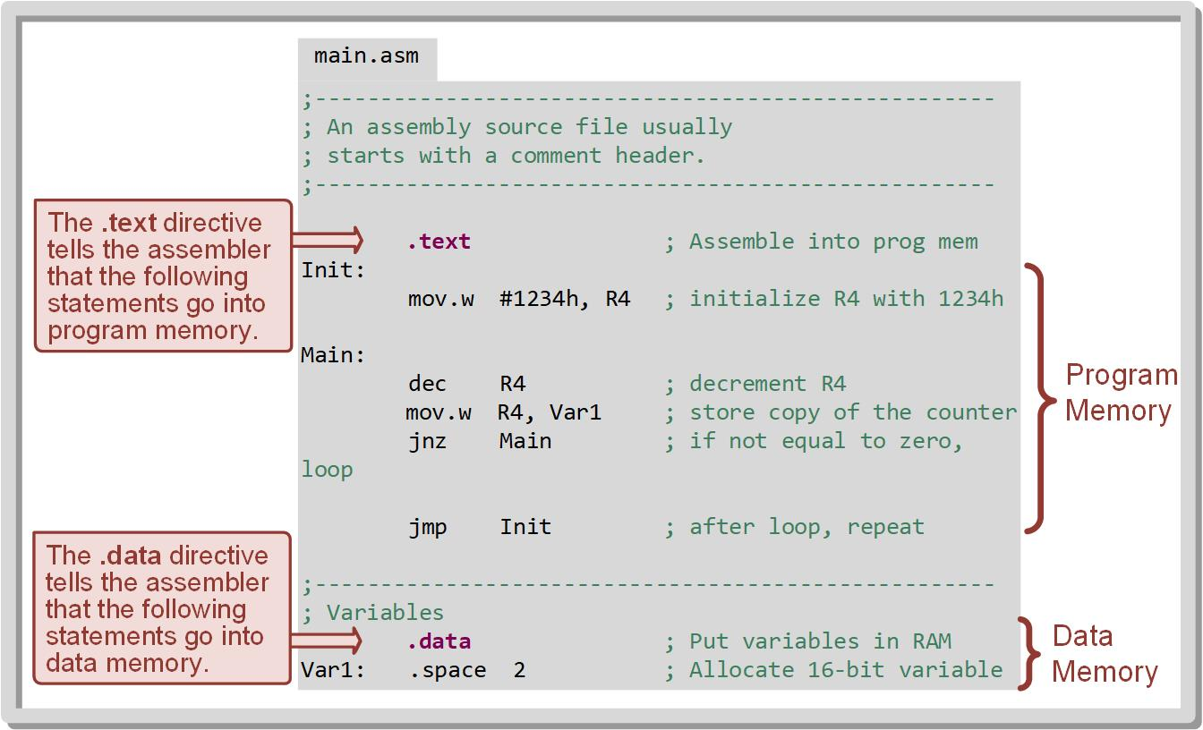
Ch. 5: Getting Started Programming the MSP430 in Assembly
5.1.2 Assembler Directives
Assembler directive – a statement in the source file that tells the assembler information about the program but is not actual instruction.
5.1 The Anatomy of an Assembly Program File

Slide 19
Ch. 5: Getting Started Programming the MSP430 in Assembly
5.1.2 Assembler Directives
A directive begins with a period (.) and must be preceded by a whitespace.
5.1 The Anatomy of an Assembly Program File

Slide 20
Ch. 5: Getting Started Programming the MSP430 in Assembly
5.1.2 Assembler Directives
A directive begins with a period (.) and must be preceded by a whitespace.
Used to locate instructions within program memory, allocate variable space in data memory, setup constants, and manage global variable access.
5.1 The Anatomy of an Assembly Program File

Slide 21
Ch. 5: Getting Started Programming the MSP430 in Assembly
5.1.2 Assembler Directives
A directive begins with a period (.) and must be preceded by a whitespace.
Used to locate instructions within program memory, allocate variable space in data memory, setup constants, and manage global variable access.
Directives typically are listed in the same column as the mnemonics field of instruction statements.
5.1 The Anatomy of an Assembly Program File

Slide 22
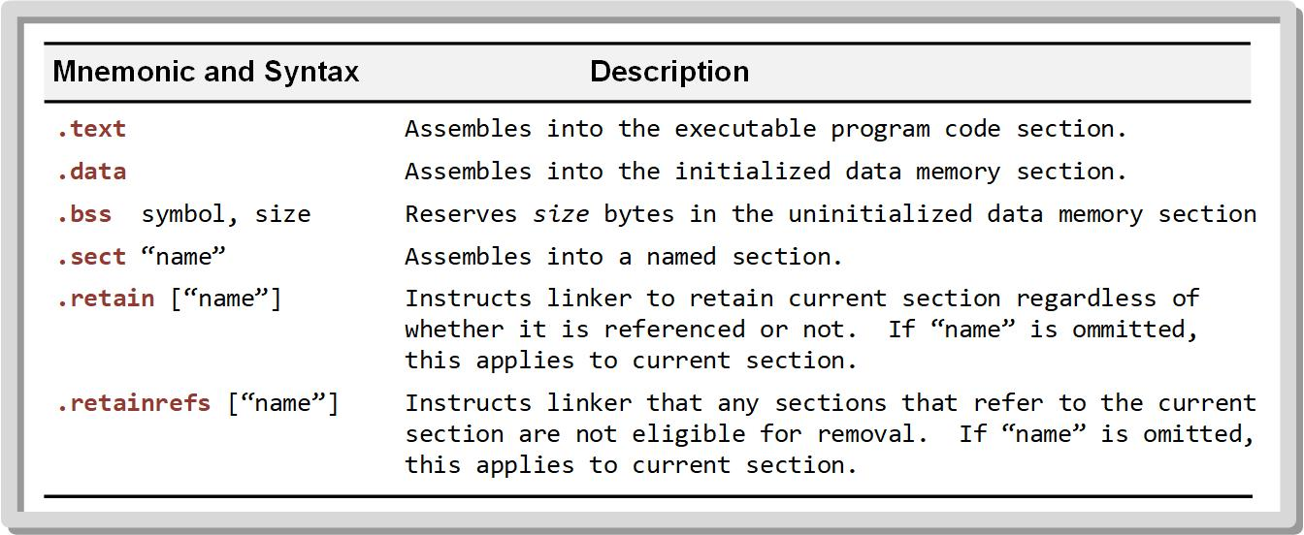
Ch. 5: Getting Started Programming the MSP430 in Assembly
5.1.2 Assembler Directives
The following Table gives a list of directives that are used to control memory use.
5.1 The Anatomy of an Assembly Program File

Slide 23
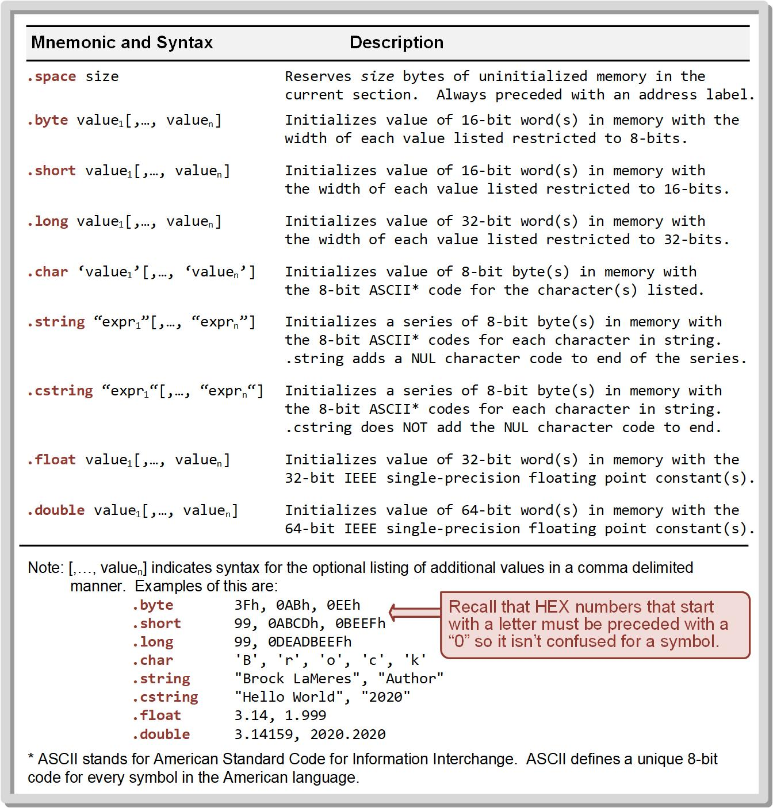
Ch. 5: Getting Started Programming the MSP430 in Assembly
5.1.2 Assembler Directives
The following table gives a list of directives that are used to reserve and/or initialize variables and constants in both data and program memory.
5.1 The Anatomy of an Assembly Program File

Slide 24
Ch. 5: Getting Started Programming the MSP430 in Assembly
5.1.2 Assembler Directives
Variables initialized in data memory are done so during download to the MCU and are then treated as R/W during program operation.
5.1 The Anatomy of an Assembly Program File

Slide 25
Ch. 5: Getting Started Programming the MSP430 in Assembly
5.1.2 Assembler Directives
Constants initialized in program memory are also done so during download to the MCU but are treated as ROM during program operation.
Address labels are used with these directives to track the allocations memory.
5.1 The Anatomy of an Assembly Program File

Slide 26
Ch. 5: Getting Started Programming the MSP430 in Assembly
5.1.2 Assembler Directives
Let’s look at some examples of constants…
5.1 The Anatomy of an Assembly Program File

Slide 27
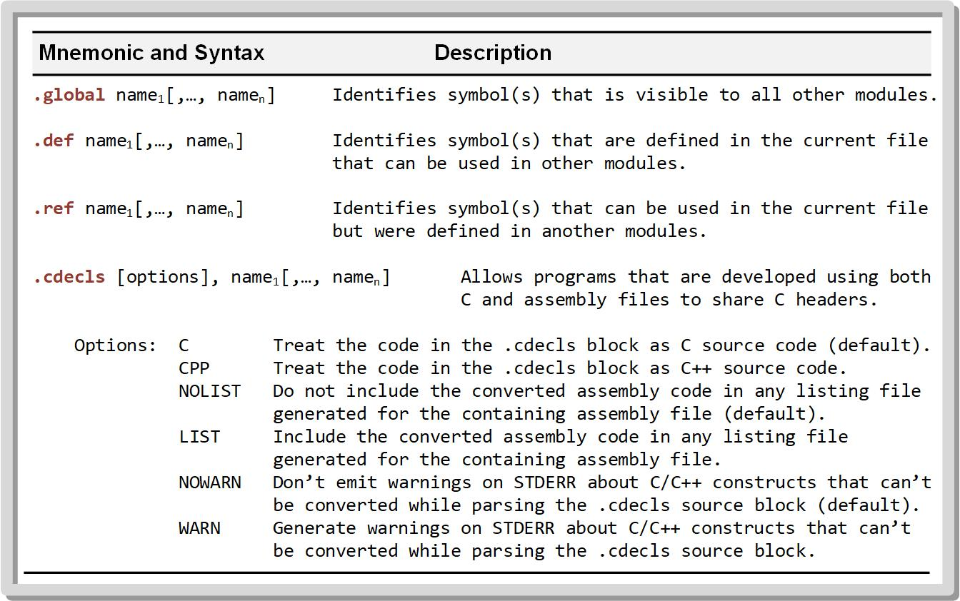
Ch. 5: Getting Started Programming the MSP430 in Assembly
5.1.2 Assembler Directives
The following table gives a list of directives that are used to control interchange of information between multiple design files within a CCS project.
5.1 The Anatomy of an Assembly Program File

Slide 28
Ch. 5: Getting Started Programming the MSP430 in Assembly
5.1.2 Assembler Directives
These include directives to pass labels back and forth between files, making variables globally visible, and allowing C and assembly files to work together in a mixed-language development environment.
5.1 The Anatomy of an Assembly Program File

Slide 29
Ch. 5: Getting Started Programming the MSP430 in Assembly
5.1.2 Assembler Directives
Example assembly program that includes instructions and directives.
5.1 The Anatomy of an Assembly Program File

Slide 30

Ch. 5: Getting Started Programming the MSP430 in Assembly
5.1.3 Miscellaneous Syntax Notes
5.1.3.1 Identifiers
Identifiers – names used for labels, registers, and symbols which uses a string of alphanumeric characters, the dollar sign, and underscores (A-Z, a-z, 0-9, and _).
First character cannot be a number and cannot contain embedded blanks.
Case sensitive.
MCU contains built in identifiers for CPU register names.
Image Courtesy of
Recording Connection of Canada
Image Courtesy of Space Science and Engineering
https://www.ssec.wisc.edu/software/
5.1 The Anatomy of an Assembly Program File

Slide 31
Ch. 5: Getting Started Programming the MSP430 in Assembly
5.1.3 Miscellaneous Syntax Notes
5.1.3.2 Sections
Sections – a block of code or data that occupy a continuous space in a memory map.
Main ways to define the start of a section: .text, .data, and .sect.
The linker handles inserting the sections at the appropriate addresses in the memory map.
Image Courtesy of
Recording Connection of Canada
Image Courtesy of Space Science and Engineering
https://www.ssec.wisc.edu/software/
5.1 The Anatomy of an Assembly Program File

Slide 32
Ch. 5: Getting Started Programming the MSP430 in Assembly
5.1.3 Miscellaneous Syntax Notes
5.1.3.3 Case Sensitivity
The CCS environment is not case sensitive on mnemonics (i.e., MOV.W is the same as mov.w).
However, identifiers are case sensitive (i.e., Main ≠ main).
Image Courtesy of
Recording Connection of Canada
Image Courtesy of Space Science and Engineering
https://www.ssec.wisc.edu/software/
5.1 The Anatomy of an Assembly Program File

Slide 33

Embedded Systems Design
Chapter 5: Getting Started Programming the MSP430 in Assembly
5.1 The Anatomy of an Assembly Program File
www.youtube.com/c/DigitalLogicProgramming_LaMeres
Brock J. LaMeres, Ph.D.

Slide 34
Embedded Systems Design
Chapter 5: Getting Started Programming the MSP430 in Assembly
5.2 Your First Program – Installing CCS
Brock J. LaMeres, Ph.D.

Slide 35
Embedded Systems Design
Chapter 5: Getting Started Programming the MSP430 in Assembly
5.2 Your First Program – Installing CCS
www.youtube.com/c/DigitalLogicProgramming_LaMeres
Image Courtesy of
Recording Connection of Canada
Brock J. LaMeres, Ph.D.

Slide 36
Embedded Systems Design
Chapter 5: Getting Started Programming the MSP430 in Assembly
5.2 Your First Program – Blinking LED
Image Courtesy of
Recording Connection of Canada
Brock J. LaMeres, Ph.D.

Slide 37
Ch. 5: Getting Started Programming the MSP430 in Assembly
Steps to Creating a Blank CCS Assembly Project
Step 1: Launch CCS
Start → Texas Instruments → Code Composer Studio 9.x.x
Step 2: Create a new project
File → New → CCS Project
Step 3: In the “Target field,” select MSP430FR2355
Step 4: The first time launching CCS, you need to specify the location to place your CCS workspace. Uncheck “Use Defalt Location” and all new projects will be placed to the selected location by default.
Image Courtesy of
Recording Connection of Canada
5.2 Your First Program – Blinking LED

Slide 38
Ch. 5: Getting Started Programming the MSP430 in Assembly
Steps to Creating a Blank CCS Assembly Project
Step 5: In the “Project Name” field, enter: Asm_Blinky
Step 6: In “Project Templates and Examples,” select: Empty Assembly-only Project
Step 7: click: Finish
Image Courtesy of
Recording Connection of Canada
5.2 Your First Program – Blinking LED

Slide 39
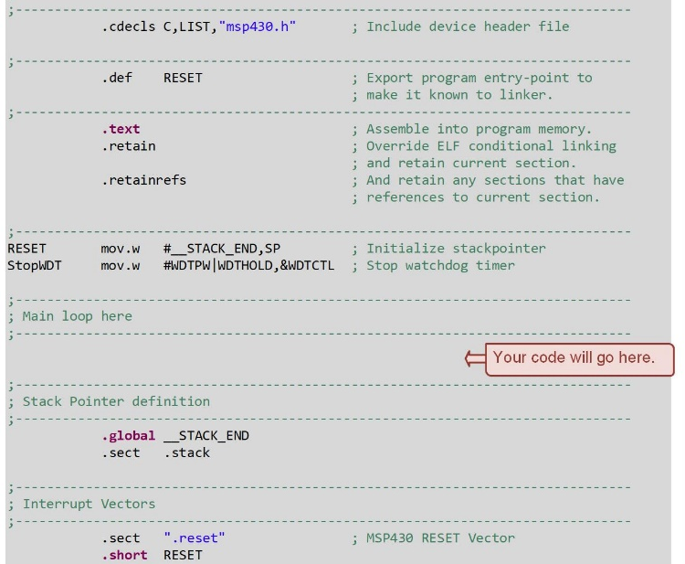
Ch. 5: Getting Started Programming the MSP430 in Assembly
Inspection of the Source Code Provided by CCS
.cdecls – pulls a header file that defines register and bit names for the MSP430.
.def – allows the address label RESET to be seen on other project files.
.text – tells the assembler that the following statements will be put into the program code portion of the memory map.
.retain and .retainrefs – prevent any section from being automatically removed when CCS tries to optimize the design.
Image Courtesy of
Recording Connection of Canada
5.3 Using the CCS Debugger

Slide 40
Ch. 5: Getting Started Programming the MSP430 in Assembly
Inspection of the Source Code Provided by CCS
The first statement beginning with “RESET” initializes the SP register to the end of the data memory.
The second statement beginning with StopWDT configures some settings in a peripheral register that disable the watchdog timer.
A set of comment lines that state “Main loop here” indicate where your program will go.
__STACK_END – address that represents the end of data memory.
Image Courtesy of
Recording Connection of Canada
5.3 Using the CCS Debugger

Slide 41
Ch. 5: Getting Started Programming the MSP430 in Assembly
Inspection of the Source Code Provided by CCS
.global – allows all other files in the project to see this address.
The interrupt vector section is defined using directives to define the starting address of program code and place it in a system called the interrupt controller with will handle retrieving the address and placing it into PC upon power up.
Image Courtesy of
Recording Connection of Canada
5.3 Using the CCS Debugger

Slide 42
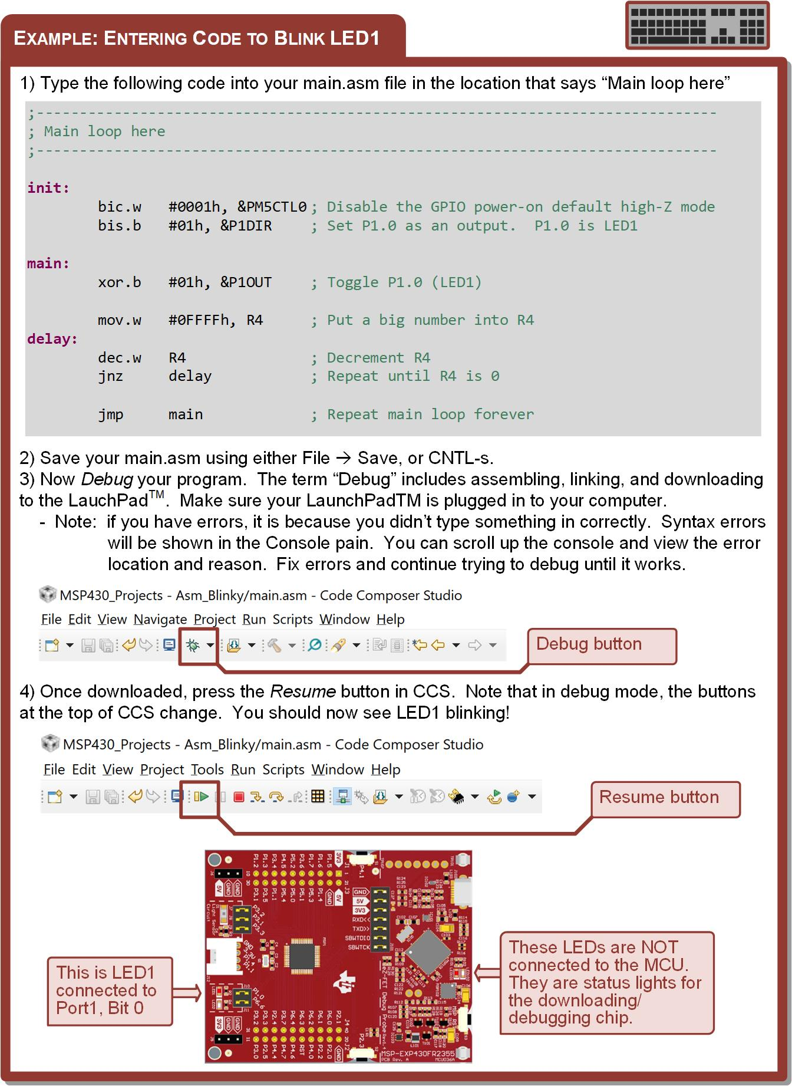
Ch. 5: Getting Started Programming the MSP430 in Assembly
Entering Code to Blink LED1
Step 1: Type the following code into your main.asm file in the location that says “Main loop here”
Image Courtesy of
Recording Connection of Canada
5.3 Using the CCS Debugger

Slide 43
Ch. 5: Getting Started Programming the MSP430 in Assembly
Entering Code to Blink LED1
Step 2: Save your main.asm
File → Save or CNTL-s
Step 3: Debug your program – Press the Debug Icon
Step 4: Once downloaded, press the Resume button
Image Courtesy of
Recording Connection of Canada
5.3 Using the CCS Debugger

Slide 44
Embedded Systems Design
Chapter 5: Getting Started Programming the MSP430 in Assembly
5.2 Your First Program – Blinking LED
www.youtube.com/c/DigitalLogicProgramming_LaMeres
Image Courtesy of
Recording Connection of Canada
Brock J. LaMeres, Ph.D.

Slide 45
Embedded Systems Design
Chapter 5: Getting Started Programming the MSP430 in Assembly
5.3 Using the CCS Debugger
Image Courtesy of
Recording Connection of Canada
Brock J. LaMeres, Ph.D.

Slide 46

Ch. 5: Getting Started Programming the MSP430 in Assembly
Using the CCS Debugger
The debugger allows you to start, stop, and pause your program to observe its operation.
It also allows you to view the contents of registers and memory at specific points in your program.
The debugger allows you to also view the binary values that your program is assembled into.
In C, the debugger also allows you to see the assembly file that is created during compile.
Image Courtesy of
Recording Connection of Canada
Image Courtesy of GetDrawings.com
http://getdrawings.com/icon-tag/debug
5.3 Using the CCS Debugger

Slide 47
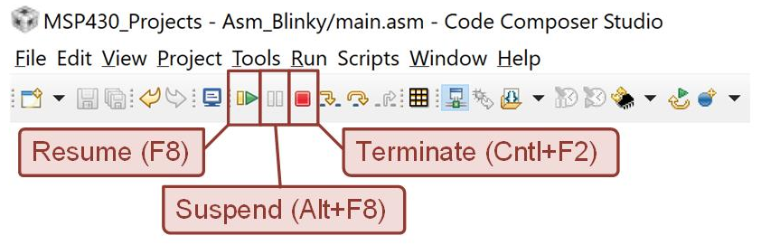
Ch. 5: Getting Started Programming the MSP430 in Assembly
5.3.1 Resume, Terminate, and Suspend
Once a program is in debug mode, the resume, suspend, and terminate commands become available.
Resume – starts running your program.
Suspend – pauses your program without ending debug mode.
Terminate – ends your program and exits debug mode.
Image Courtesy of
Recording Connection of Canada
5.3 Using the CCS Debugger

Slide 48
Ch. 5: Getting Started Programming the MSP430 in Assembly
5.3.2 Breakpoints
Breakpoint – a stopping point in the code that can be inserted by the debugger.
When a program is run, if it encounters a breakpoint it will automatically suspend.
Breakpoints allow a developer to suspend a program in a specific point and then simply resume the program and monitor activity once it suspends.
A breakpoint is inserted by double clicking in the grey, vertical string to the left of the editor pane.
Image Courtesy of
Recording Connection of Canada
Image Courtesy of GetDrawings.com
http://getdrawings.com/icon-tag/debug
5.3 Using the CCS Debugger

Slide 49
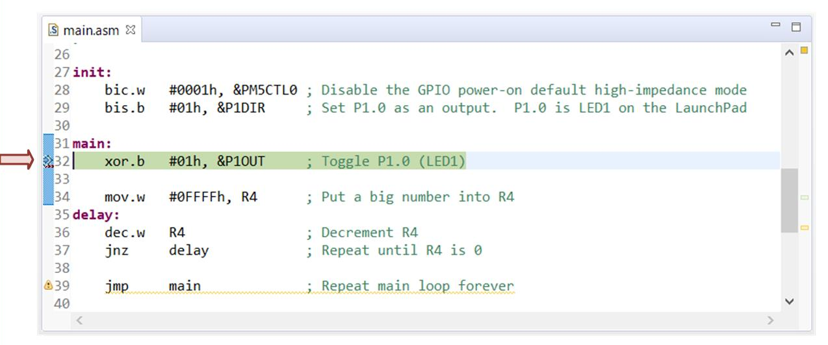
Ch. 5: Getting Started Programming the MSP430 in Assembly
5.3.2 Breakpoints
Step 1: Make sure you program is in debug mode.
Step 2: Enter a breakpoint before the xor.b instruction. Once the breakpoint is entered, a blue circle will appear.
Step 3: Press the Resume button. Your program will run to the breakpoint and pause.
Image Courtesy of
Recording Connection of Canada
5.3 Using the CCS Debugger

Slide 50
Ch. 5: Getting Started Programming the MSP430 in Assembly
5.3.3 Viewing Register Contents
The register viewer within CCS allows you to see the contents of CPU registers when your program is suspended.
It allows you to expand the Status Register to see the ALU flags.
Image Courtesy of
Recording Connection of Canada
Image Courtesy of GetDrawings.com
http://getdrawings.com/icon-tag/debug
5.3 Using the CCS Debugger

Slide 51
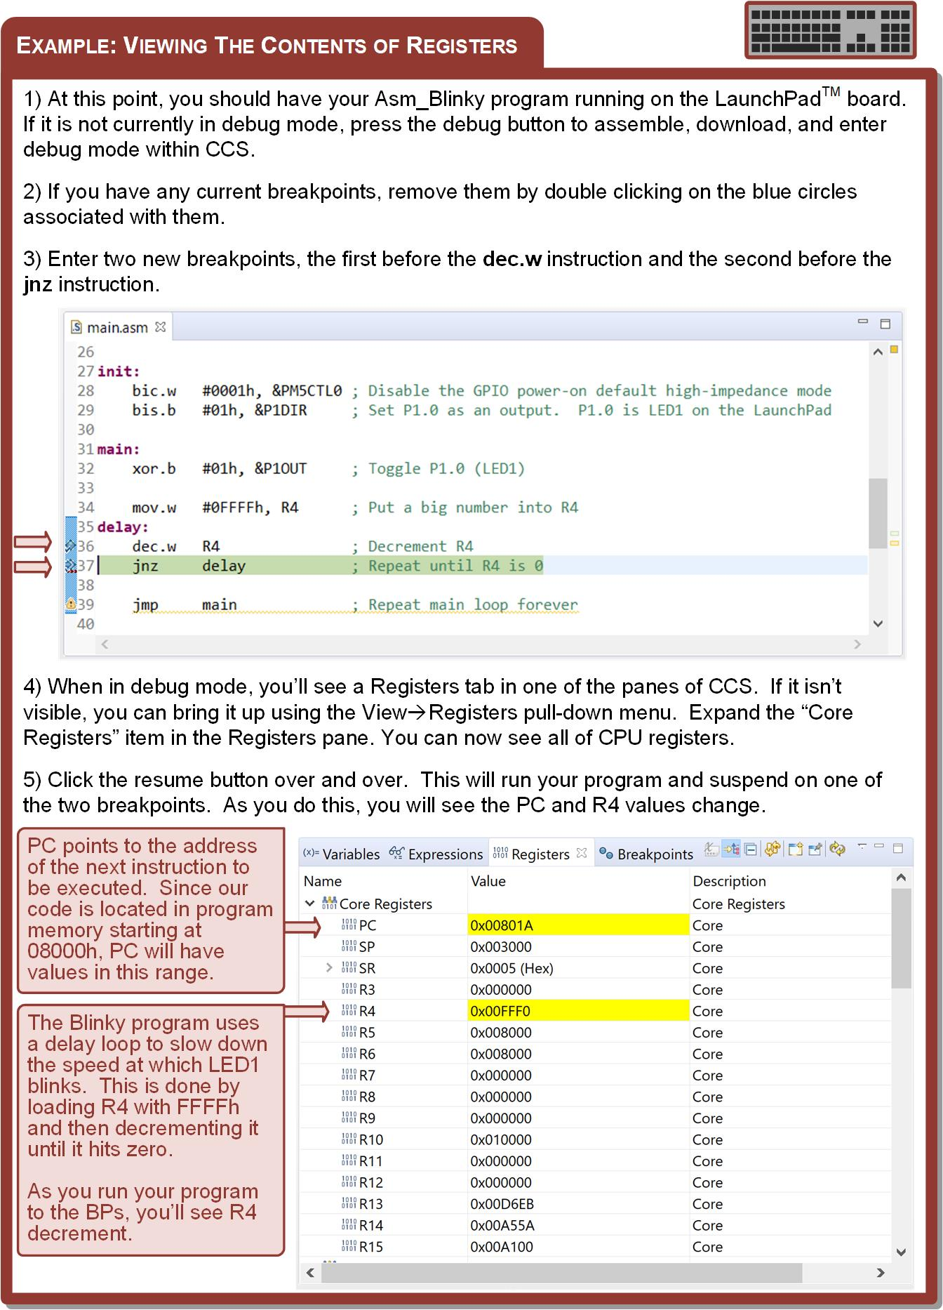
Ch. 5: Getting Started Programming the MSP430 in Assembly
5.3.3 Viewing Register Contents
Step 1: Make sure you program is in debug mode.
Step 2: Enter a breakpoint before the dec.w instruction, and a second before the jnz instruction.
Image Courtesy of
Recording Connection of Canada
5.3 Using the CCS Debugger

Slide 52
Ch. 5: Getting Started Programming the MSP430 in Assembly
5.3.3 Viewing Register Contents
Step 3: When in debug mode, you’ll se a Registers tab in one of the panes of CCS. If this isn’t visible, you can bring it up using the View → Registers pull-down menu.
Step 4: Click the resume button over and over. This will run your program and suspend on one of the two breakpoints. As you do this, you will see the PC and R4 values change.
Image Courtesy of
Recording Connection of Canada
5.3 Using the CCS Debugger

Slide 53
Ch. 5: Getting Started Programming the MSP430 in Assembly
5.3.3 Viewing Register Contents
Image Courtesy of
Recording Connection of Canada
5.3 Using the CCS Debugger

Slide 54
Ch. 5: Getting Started Programming the MSP430 in Assembly
5.3.4 Viewing the Contents of Memory
The CCS memory browser allows you to see the contents of the memory system at each address.
This can be opened using the View →Memory Browser pull-down menu.
You can search for a certain address by typing it in the search field at the top of the window pane.
The format can be entered in either decimal or hexadecimal (uses the “0x” prefix format).
Image Courtesy of
Recording Connection of Canada
Image Courtesy of GetDrawings.com
http://getdrawings.com/icon-tag/debug
5.3 Using the CCS Debugger

Slide 55
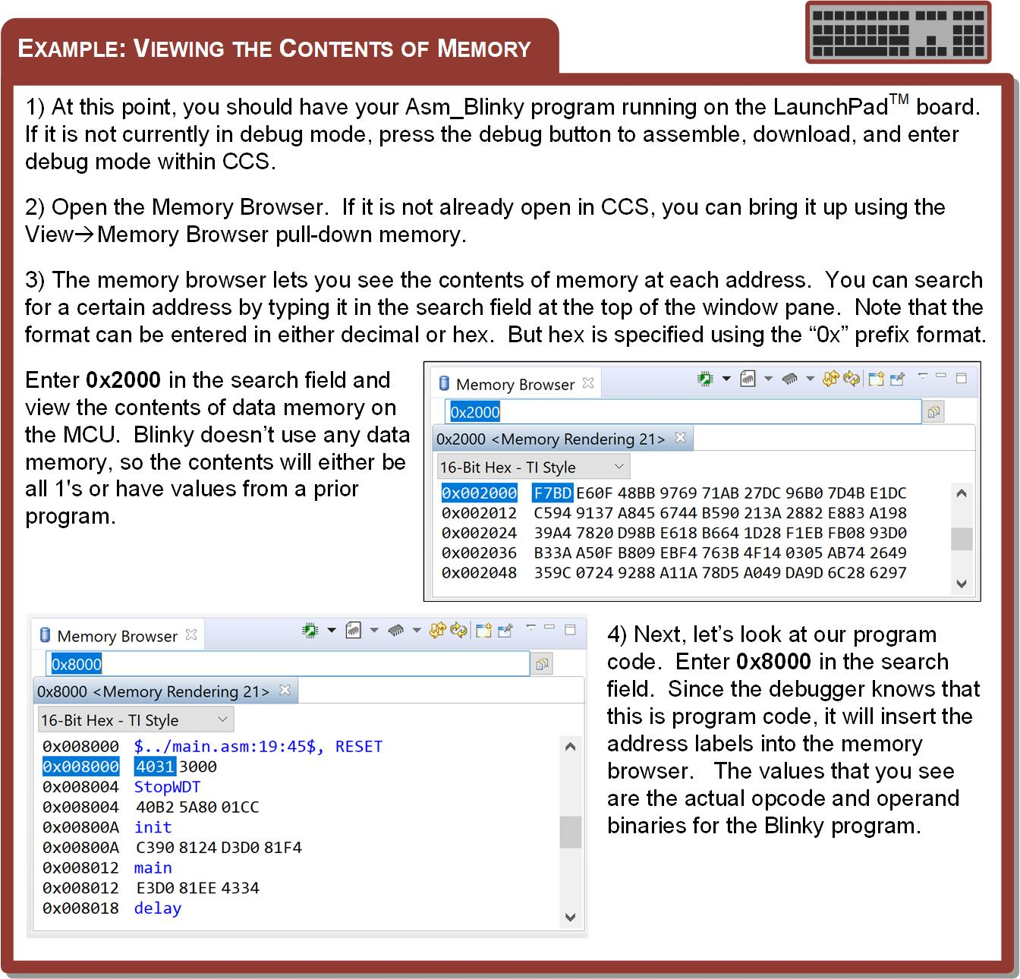
Ch. 5: Getting Started Programming the MSP430 in Assembly
5.3.4 Viewing the Contents of Memory
Step 1: Make sure you program is in debug mode.
Step 2: Open the Memory Browser.
Step 3: Enter 0x2000 in the search field and view the contents of data memory on the MCU. Blinky doesn’t use any data memory so the contents will either be all 1’s or have values from a prior program.
Image Courtesy of
Recording Connection of Canada
5.3 Using the CCS Debugger

Slide 56
Ch. 5: Getting Started Programming the MSP430 in Assembly
5.3.4 Viewing the Contents of Memory
Step 4: Next, let’s look at our program code. Enter 0x8000 in the search field. Since the debugger knows that this is program code, it will insert the address labels into the memory browser. The values that you see are the actual opcode and operand binaries for the Blinky program.
Image Courtesy of
Recording Connection of Canada
5.3 Using the CCS Debugger

Slide 57
Ch. 5: Getting Started Programming the MSP430 in Assembly
5.3.5 Stepping Your Program
Stepping – executing your program line by line.
If a subroutine exists in your program and you are using the Step Into command, when the debugger reaches the subroutine call, it will move into the subroutine as you step.
If you are using the Step Over command, it will simply execute the entire subroutine without entering it and continue to the next instruction in the main program.
Image Courtesy of
Recording Connection of Canada
Image Courtesy of GetDrawings.com
http://getdrawings.com/icon-tag/debug
5.3 Using the CCS Debugger

Slide 58
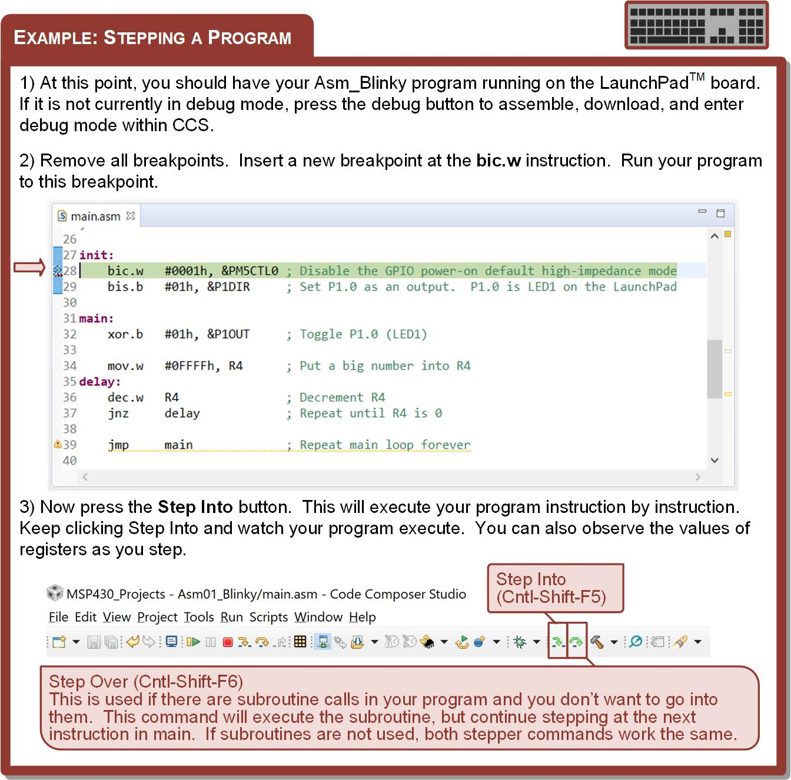
Ch. 5: Getting Started Programming the MSP430 in Assembly
5.3.5 Stepping Your Program
Step 1: Make sure you program is in debug mode.
Step 2: Enter a breakpoint before the bic.w instruction.
Image Courtesy of
Recording Connection of Canada
5.3 Using the CCS Debugger

Slide 59
Ch. 5: Getting Started Programming the MSP430 in Assembly
5.3.5 Stepping Your Program
Step 3: Now press the Step Into button. This will execute your program instruction by instruction. Keep clicking Step Into and watch your program execute.
Image Courtesy of
Recording Connection of Canada
5.3 Using the CCS Debugger

Slide 60
Embedded Systems Design
Chapter 5: Getting Started Programming the MSP430 in Assembly
5.3 Using the CCS Debugger
www.youtube.com/c/DigitalLogicProgramming_LaMeres
Image Courtesy of
Recording Connection of Canada
Brock J. LaMeres, Ph.D.

